Slide 1
第二章 半导体中光的传播
Classical Propagation of light in a dense medium
Dielectric constant by the dipole oscillator model
Properties of ε_{r}:
1) Causality: Kramers-Kronig relationships
2) Dispersion
3) Anisotropy
4) Induced optical anisotropy: The tuning o the n, κ
n, α
Notes:
教学重点：n, κ之经典对应, kk关系应用，n, κ 调控
教学难点： K-K 关系之推导；
用PPT讲，稍提前，
用文献补齐 2016.3.1

Slide 2
Propagation theory
Two propagation parameters:
Model:
Light: electromagnetic wave
Atoms and molecule: classical dipole oscillator, n(ω), α (ω)
1. bound electron (atomic) ~
2. vibrational ~
3. free electron ~
Note
Notes:
经典模型，依然是宏微交替，物穷其理。宏观现象的微观对应过程，就是建模，格物的过程，之后，所建模型的还要被拿到宏观世界进行验证。

Slide 3
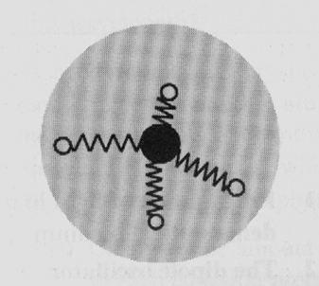
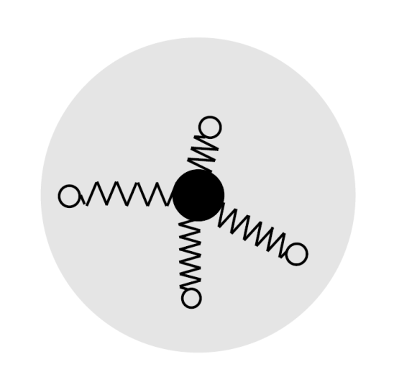
Electron oscillators
Classical model of an atom.
Electrons are bound to the nucleus by springs which determine the natural frequencies
Bound electrons (insulators, intrinsic semiconductors)
natural resonant frequency ω₀ : infrared / visible / UV spectral regions 10¹⁴-10¹⁵ Hz
Free electrons (metals, doped insulators)
• ω₀ = 0 Drude-Lorentz model
(note)
Notes:
1878 Lorentz
1888 EM wave Hertz
Electron found by J. J. Thomson
In 1896, the British physicist J. J. Thomson, with his colleagues John S. Townsend and H. A. Wilson,^{[13]} performed experiments indicating that cathode rays really were unique particles, rather than waves, atoms or molecules as was believed earlier
Bound electrons (insulators, intrinsic semiconductors)
• restoring force for small displacements F = – K_{s} x
⇒ natural resonant frequency ω₀ = (K_{s} /m)^{1/2}
• ω₀ lies in the near infrared / visible / UV spectral regions 10¹⁴-10¹⁵ Hz
Free electrons (metals, doped insulators)
• K_{s} = 0 ⇒ ω₀ = 0, Free electrons, K_{s} = 0, ω₀ = 0
Drude-Lorentz model

Slide 4
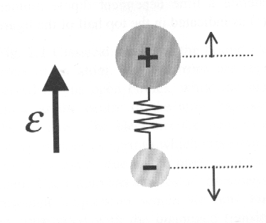
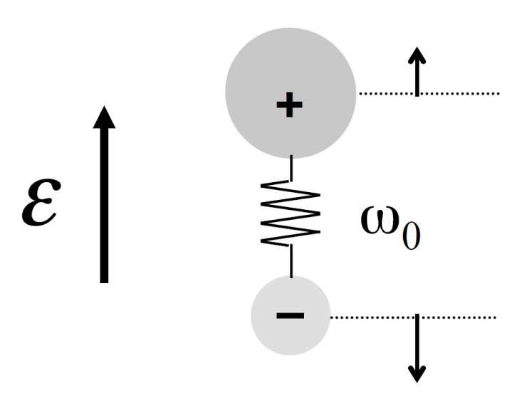
Vibrational oscillators
Classical model of a polar molecule (an ionic optical medium)
Vibrational oscillators
Molecular physics
IR absorption at resonant frequency of the vibrational modes
Ionic crystals
IR absorption at frequency of optically-active lattice vibrations i.e. the transverse optic (TO) phonons

Slide 5
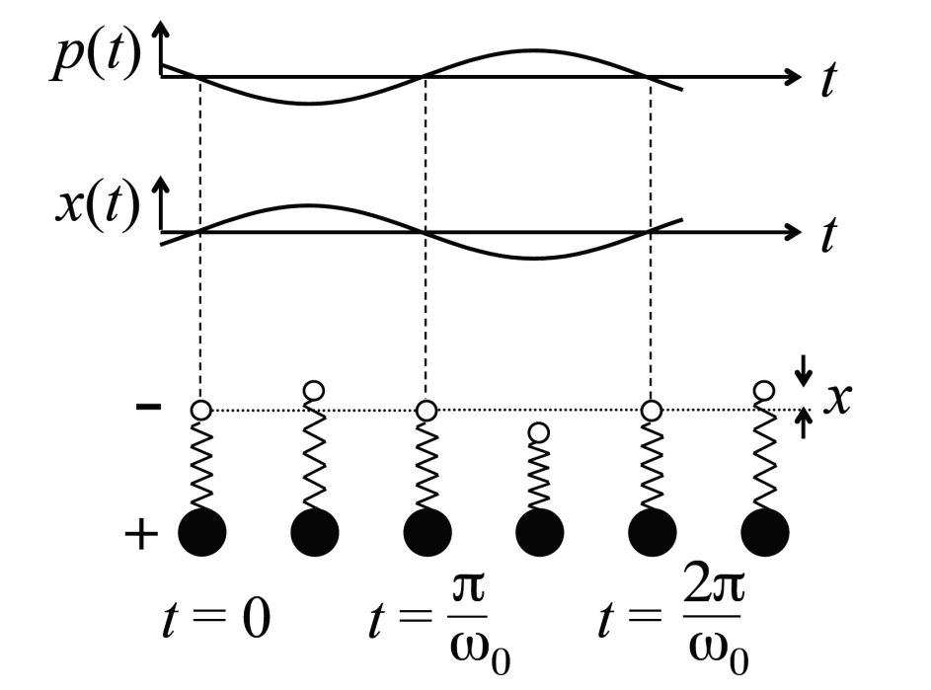
Dipole oscillators (review)
P =N p
D = ε₀ E + P = ε_{r}ε₀ E
Refractive index：
Phase lag
Light emission：
“Hertzian dipoles”
Absorption：resonance
Note
Notes:
Refractive index
If ω ≠ ω0,, non-resonant, transparent The oscillators follow the driving wave, but with a phase lag. The phase lag accumulates through the medium and retards the propagation of the wave front, leading to smaller velocity than in free space (v =c / n). -- the origin of n
Light emission
• natural oscillations at ω₀
cause radiation at ω₀
• “Hertzian dipoles”
Absorption
• light frequency = ω₀
• resonance phenomenon
• atoms absorb energy from
the light beam

Slide 6
Lorentz oscillator (detailed)
Light wave will drive oscillations at its own Frequency
Notes:
本振，简谐振动

Slide 7
Lorentz oscillator
The electric displacement D:
The macroscopic polarization of medium P:

Slide 8
Lorentz oscillator
低频
高频
偶
奇

Slide 9
Lorentz oscillator
低频
高频
按五参量，四常量（可绘图）

Slide 10
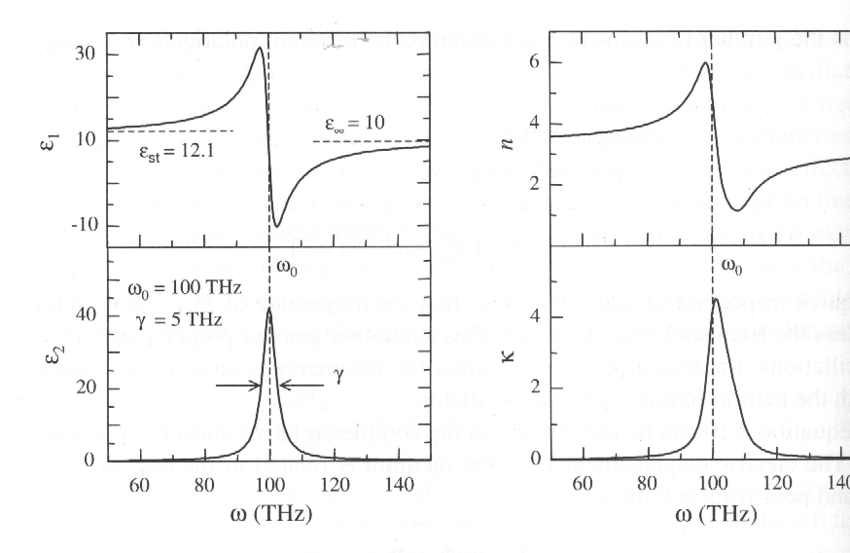
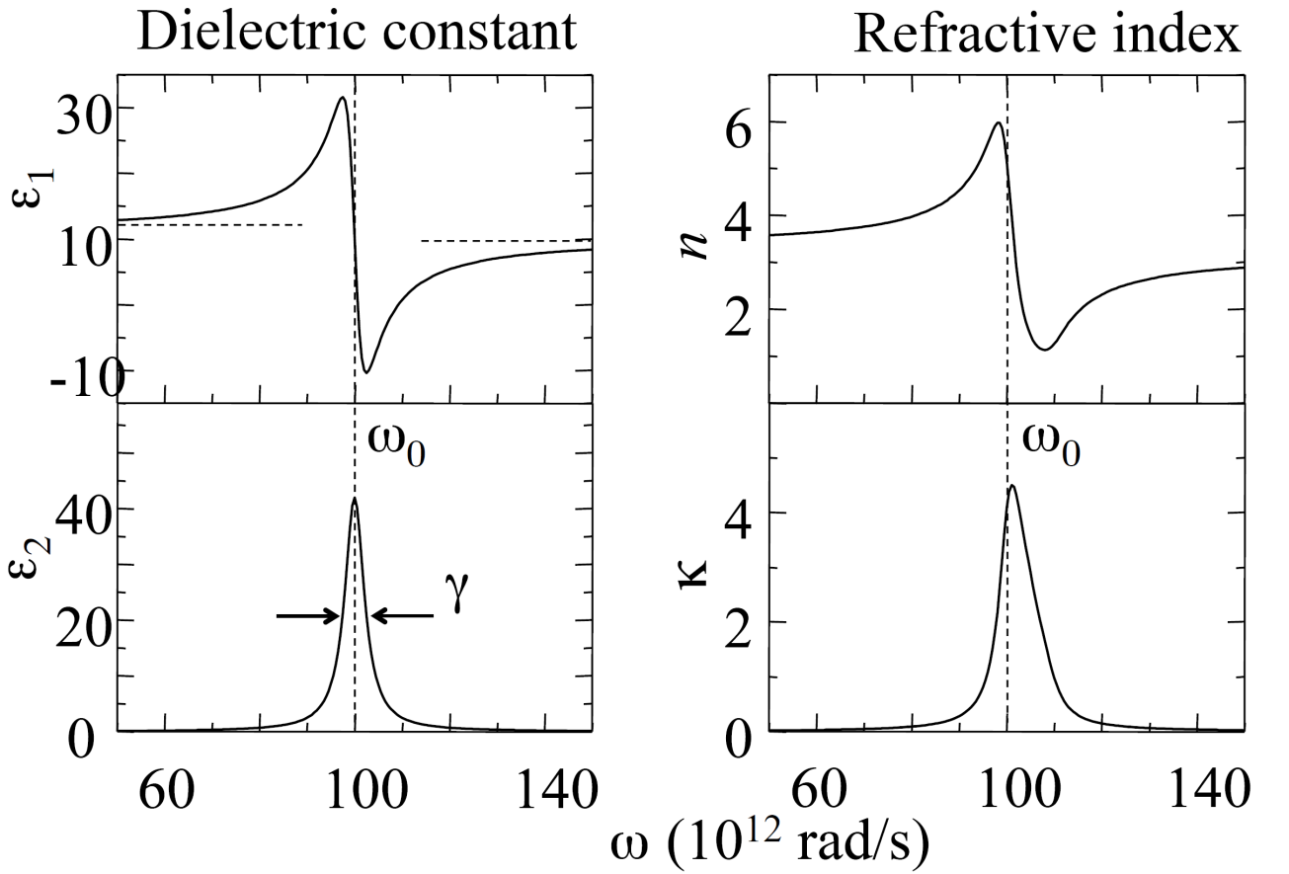
Lorentz oscillators
Lorentz oscillator
with
ω₀ = 100 THz
γ = 5 THz
ε_{st} = 12.1
ε∞ = 10



●

❍


ω_{o} ± γ间反常色散
absorption at ω₀
• FWHM = γ
●
❍
Notes:


Slide 11
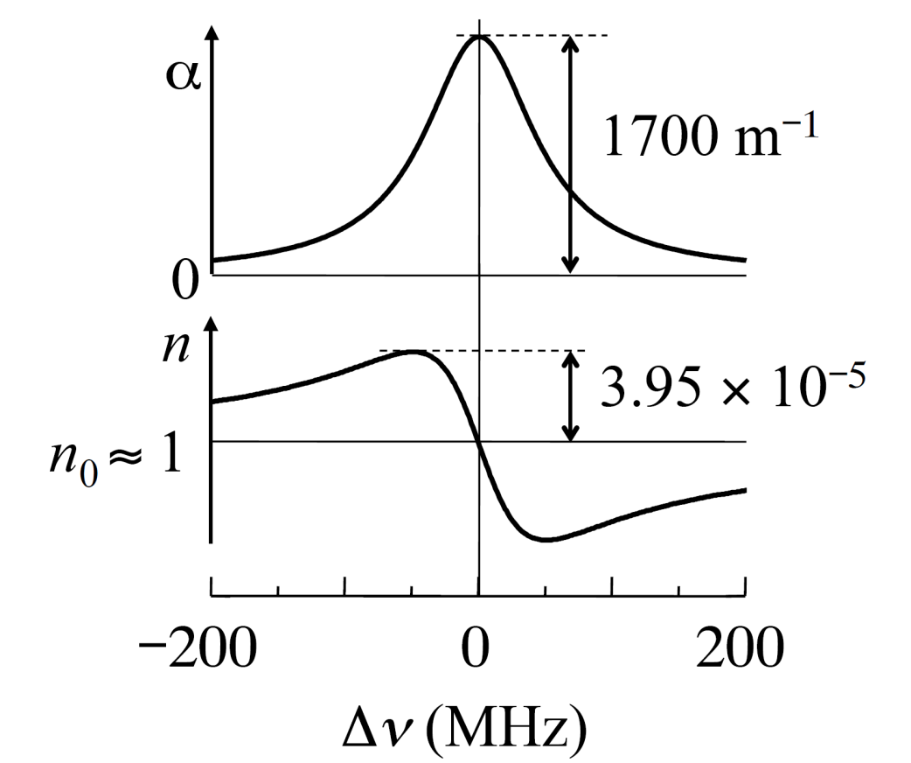
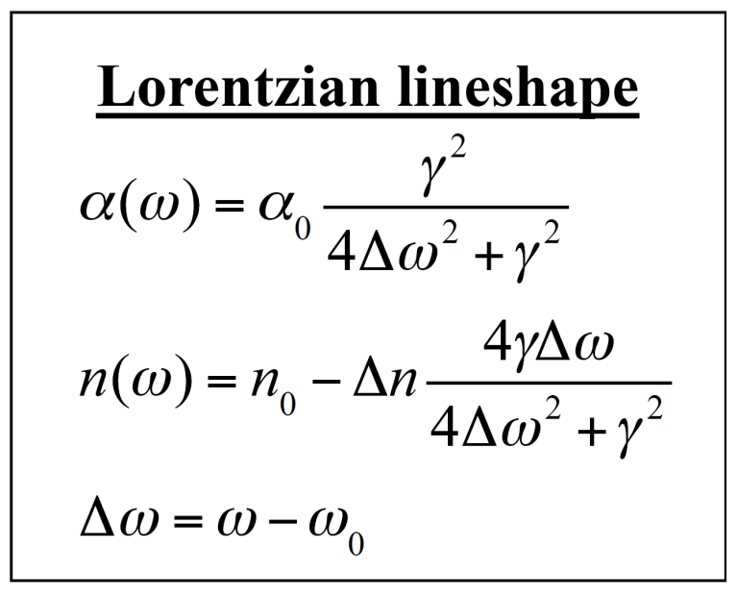
Example: atomic absorption line
• sodium gas, N = 1×10¹⁷ m^{–3} (low density → n₀ ≈1)
• D₂ line at 589.0 nm, hyperfine component with FWHM = 100 MHz

Slide 12
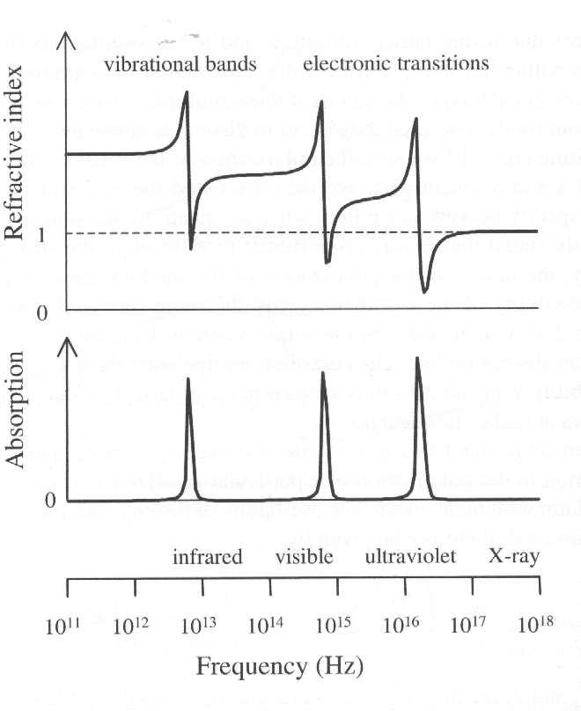
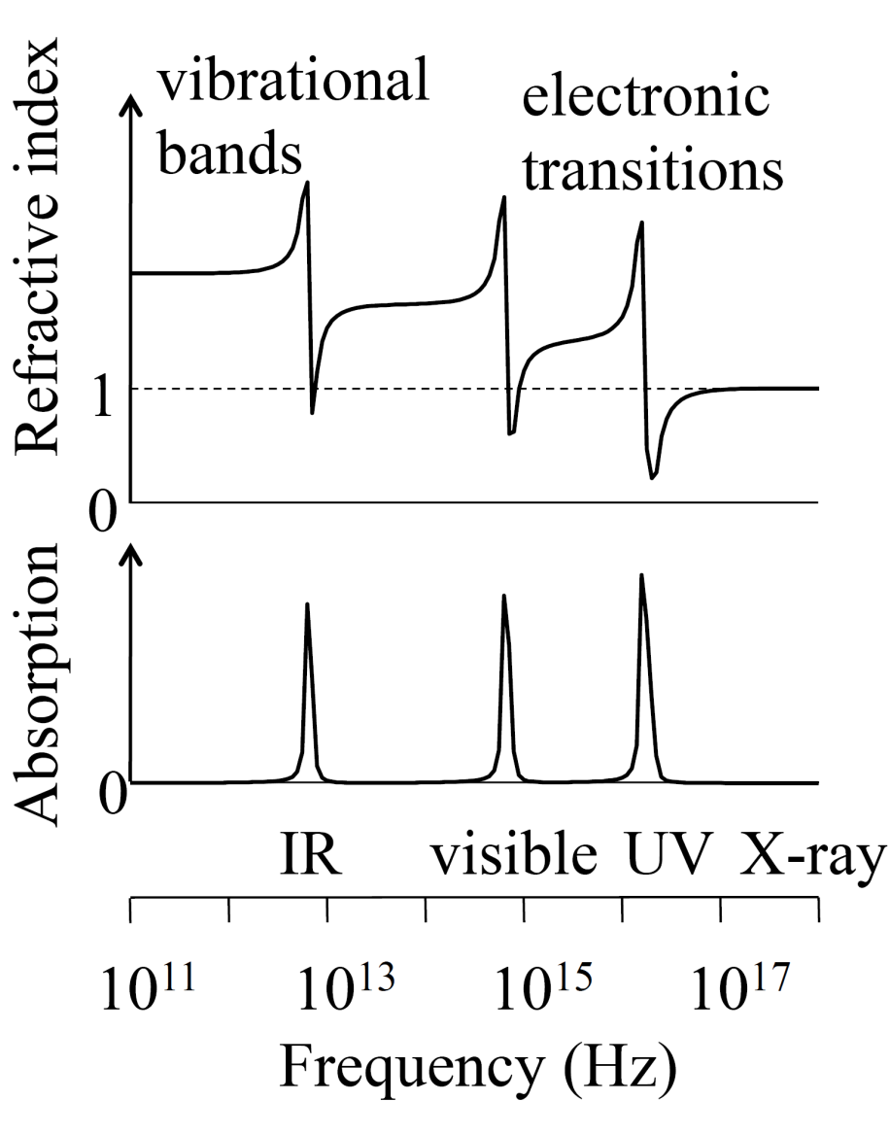
Multiple resonances
Resonant frequencies:
phonons IR/ valence electrons vis/UV core electrons X-ray

●




●
❍
❍
• f_{j} = oscillator strength
• classical theory ⇒ f_{j} = 1
• quantum theory ⇒ f_{j} determined by transition probability,

Notes:

χ ？
n<1, 相速
钻头
相速，群速，能量传递速度，信号速度

Slide 13
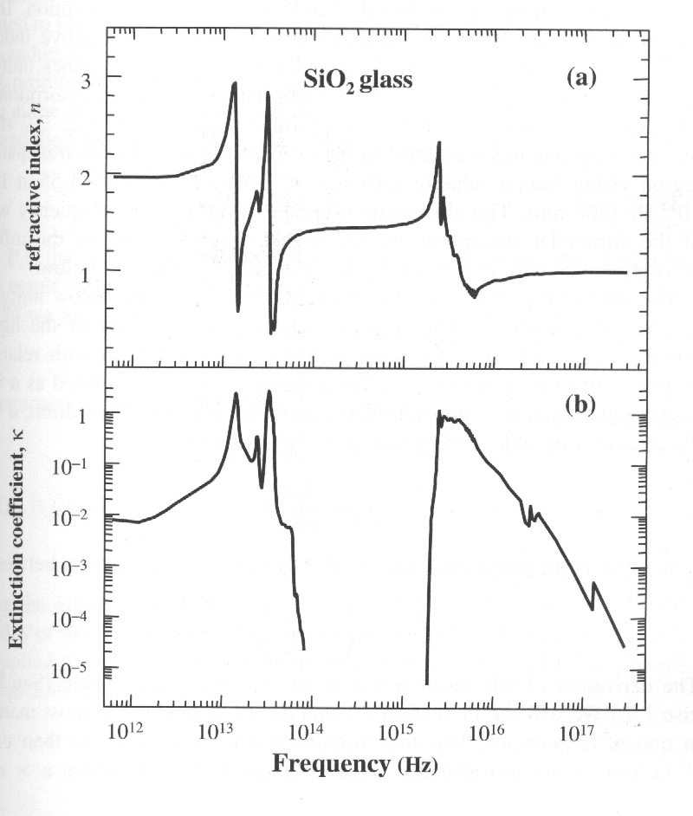
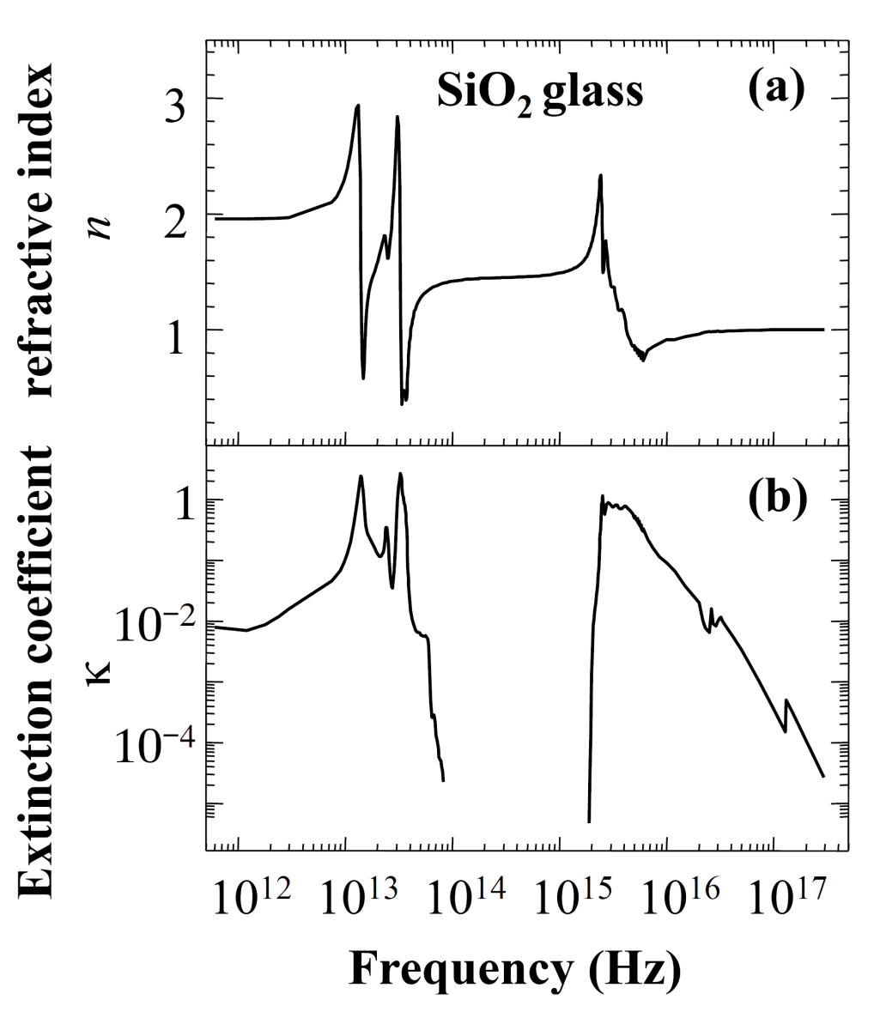
Experimental: SiO₂
band gap
phonon
Transparency
Notes:
完成“宏微交替”的过程！但尚未“物穷其理”

Slide 14
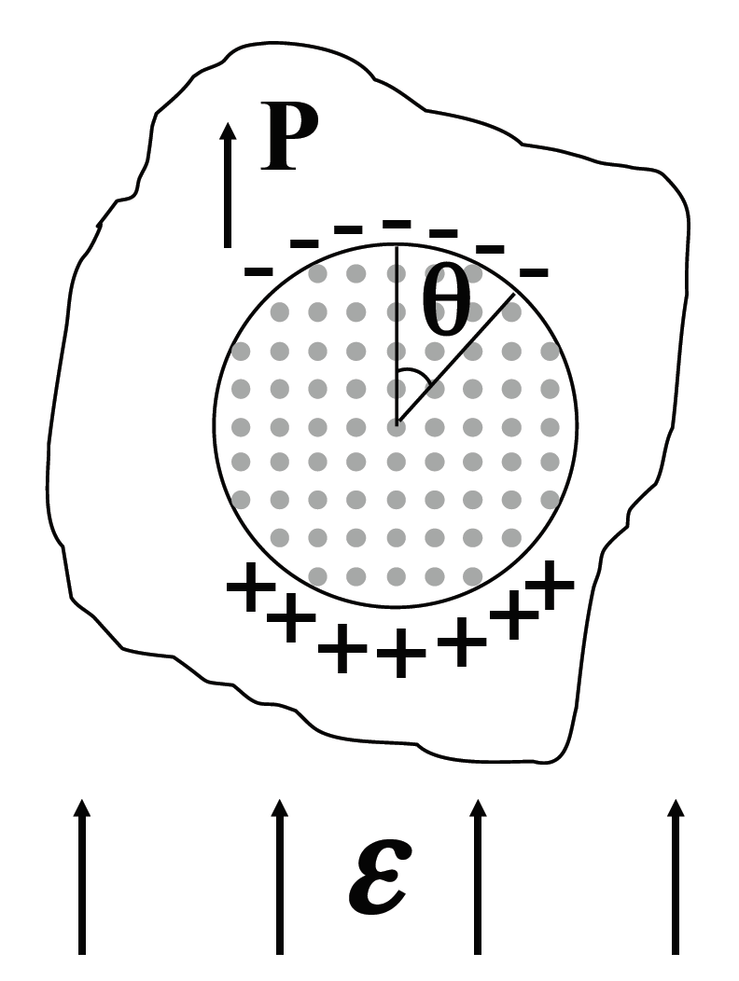
Appendix: Local field corrections
Lorentz correction:
in cubic crystal
Clausius Mossotti relationship
local field≠applied field in dense medium

Slide 15
The Kramers-Kronig relationships
n, κ
not independent:
the law of causality + complex number analysis
P indicates that the principal part of the integral should be taken. The K-K relationships allow to calculate n and κ, and vice versa.
For semiconductor
α(ω) ，
Notes:
The refractive index and the absorption coefficient are not independent parameters but are related to each other. If invoking the law of causality and apply complex number analysis, we can derive general relationships between the real and imaginary parts of the refractive index as follows:
上式到下式的过程首先是积分区间的变换（数学）接着直接加上低频（直流）电导（卡帕项）
α(ω) ，complete for light propagation
Q1: since κ=0 in visible range， why Refractive index of Glass ≠1?
In other words, since κ=0 in visible range,
then the refractive index of Glass should be 1 in visible range?
Q2: kk implication: common sense
phase Vs absorption
原始文献：Kramers kronig

Slide 16
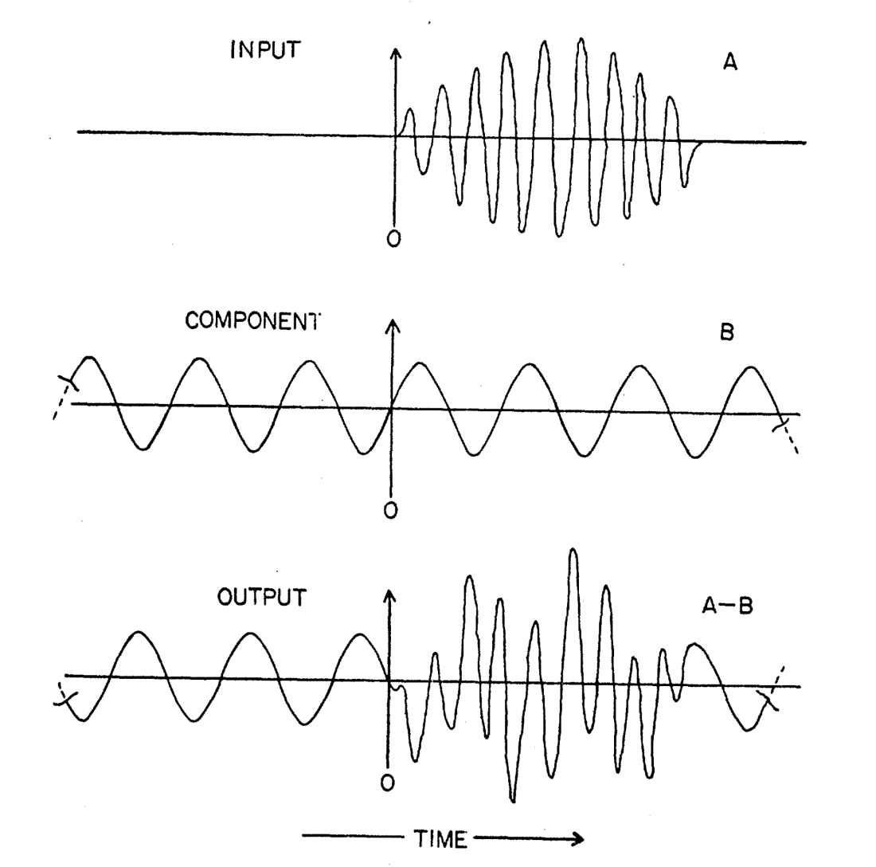
Causality and dispersion
P60, Electrodynamics of Solids
Dressel and Grűner, Cambridge
Phys. Rev. 104, 6, 1760 （1956）

Slide 17
随堂练习
P46
姓名：
Example：
Calculate the refractive index at low frequency on the assumption that ω₀ >> γ.
Solution:
20190225

Slide 18
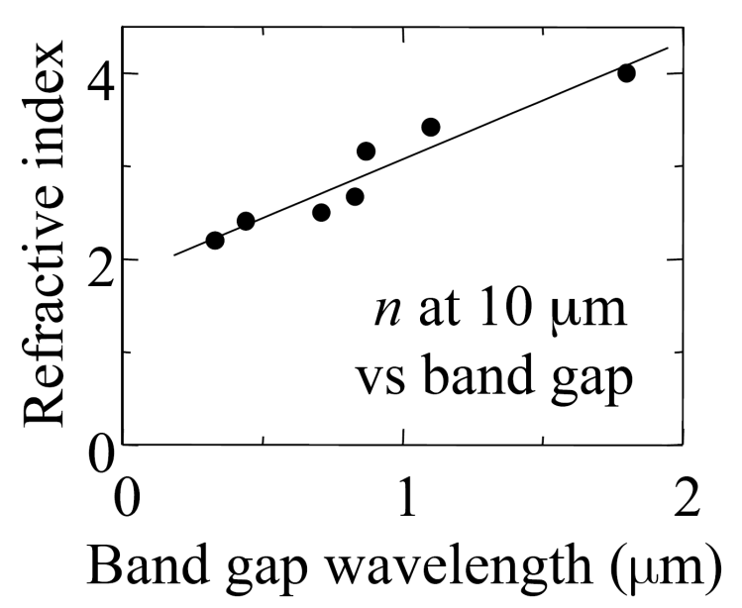
Application Example of K-K relations
• Refractive index (n) and absorption (κ) are the real and imaginary parts of the same function:
ñ = n+iκ ， thus,
• Absorption and refraction are related to each other by the Kramers–Kronig relationships
Explain the Figure

Slide 19
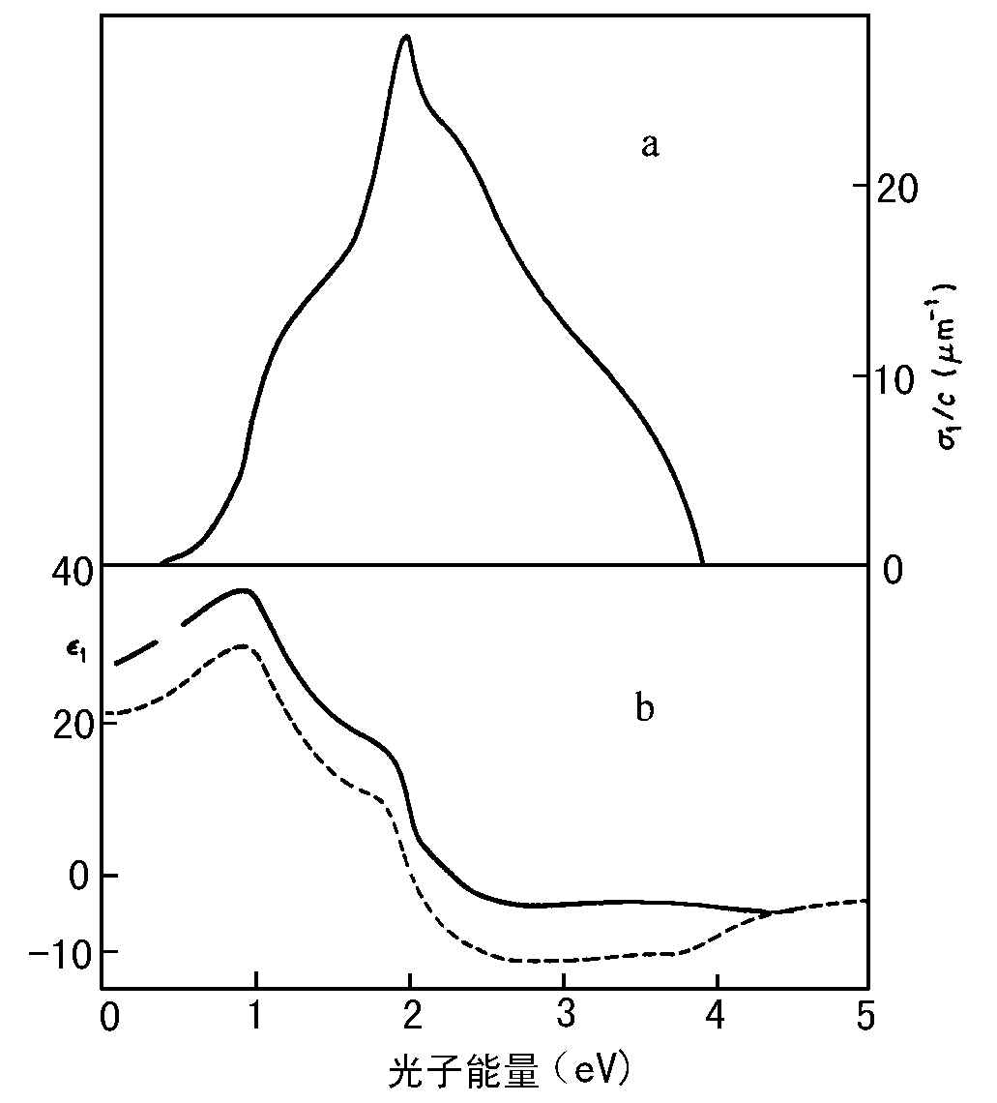
K-K关系的实验应用
将 代入，可得
93
PbTe： Gibson 1961， n=5.8
测量 n₀=5.35
(a)碲(Te)晶体的光电导谱实验数据;
(b)虚线为使用KK关系计算的ε_{r}(ω)谱； 实线为实验测得的ε_{r}(ω)谱
P 26 半导体光学 2nd 沈学础

Slide 20
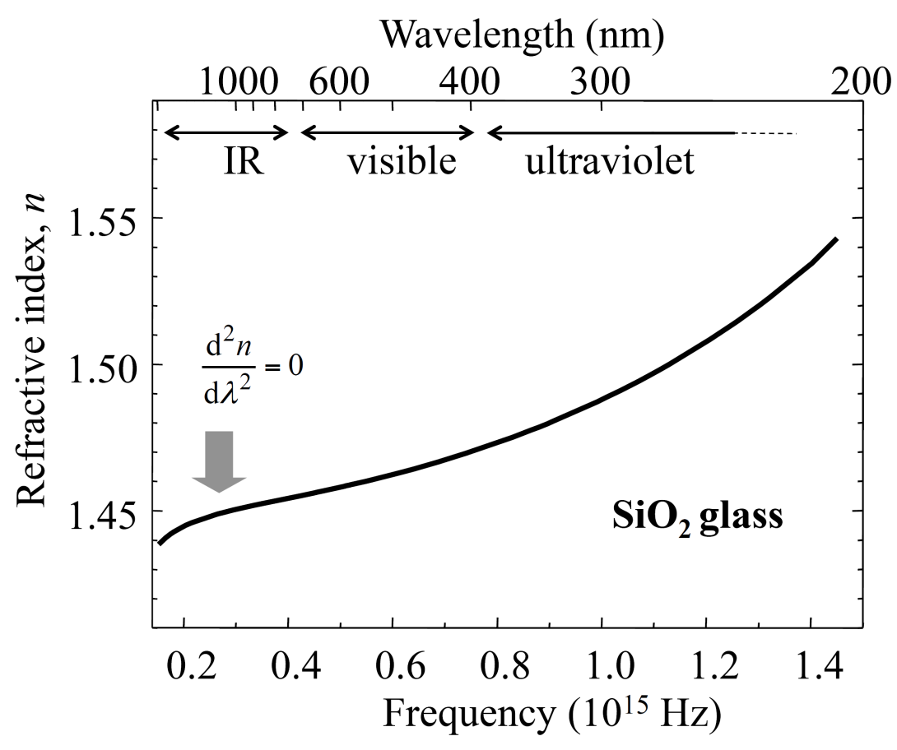
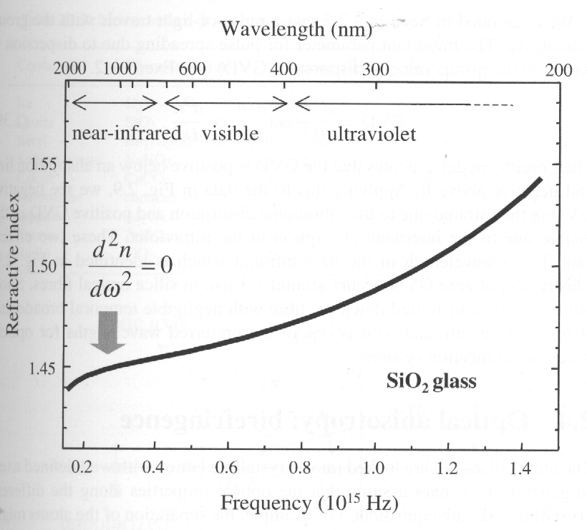
Dispersion
• Group velocity
dispersion (GVD)
• GVD determines
pulse spreading
in optical fibers
• GVD = 0 near 1300 nm
This dispersion mainly originates from the interband absorption in the UV and the vibrational absorption in IR
Notes:
The Lorentz model indicates that GVD is positive below an absorption line and negative above it. There is a region of zero GVD around 1.3 μm in silica. So short pulses can be transmitted down the silica fibre with negligible temporal broadening at this wavelength.
光脉冲展宽：空域，时域

Slide 21
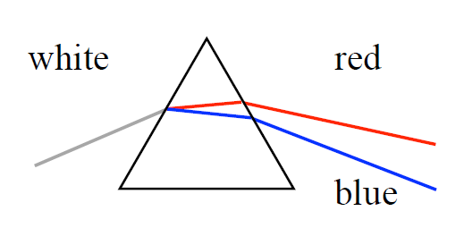
Dispersive prisms
Dispersion of light by a prism
• NORMAL dispersion: n increase with frequency
• ANOMALOUS dispersion: occurs near resonance lines
Notes:
• NORMAL dispersion: n increase with frequency
• ANOMALOUS dispersion: occurs near resonance lines
Dispersive prisms

Slide 22
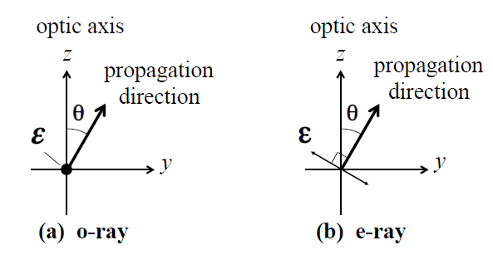
Optical anisotropy
Birefringence caused by difference of dielectric constants
(and hence refractive index) along the different crystal axes.

Slide 24
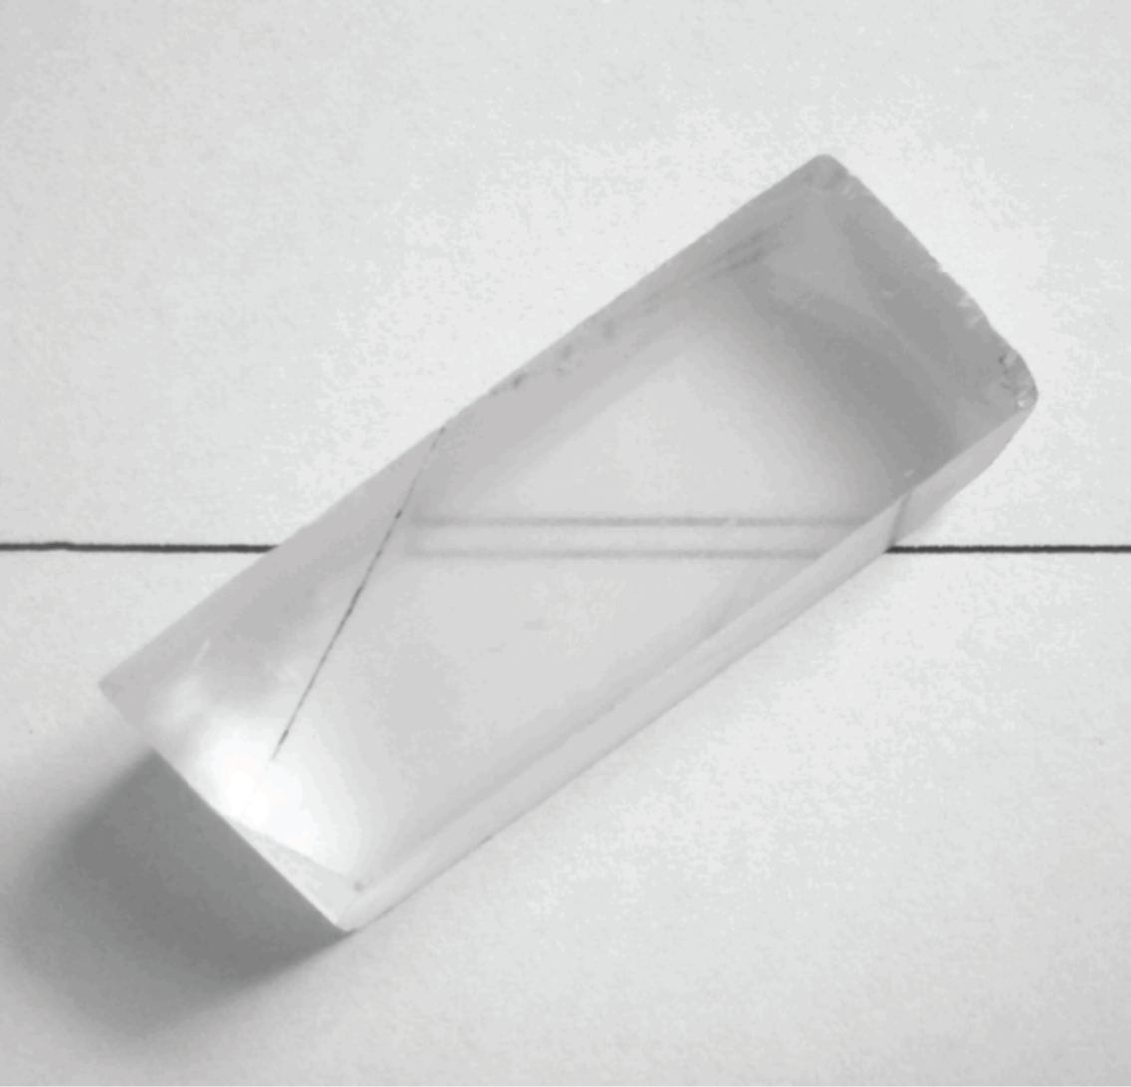
Double refraction (Birefringence)

Slide 25
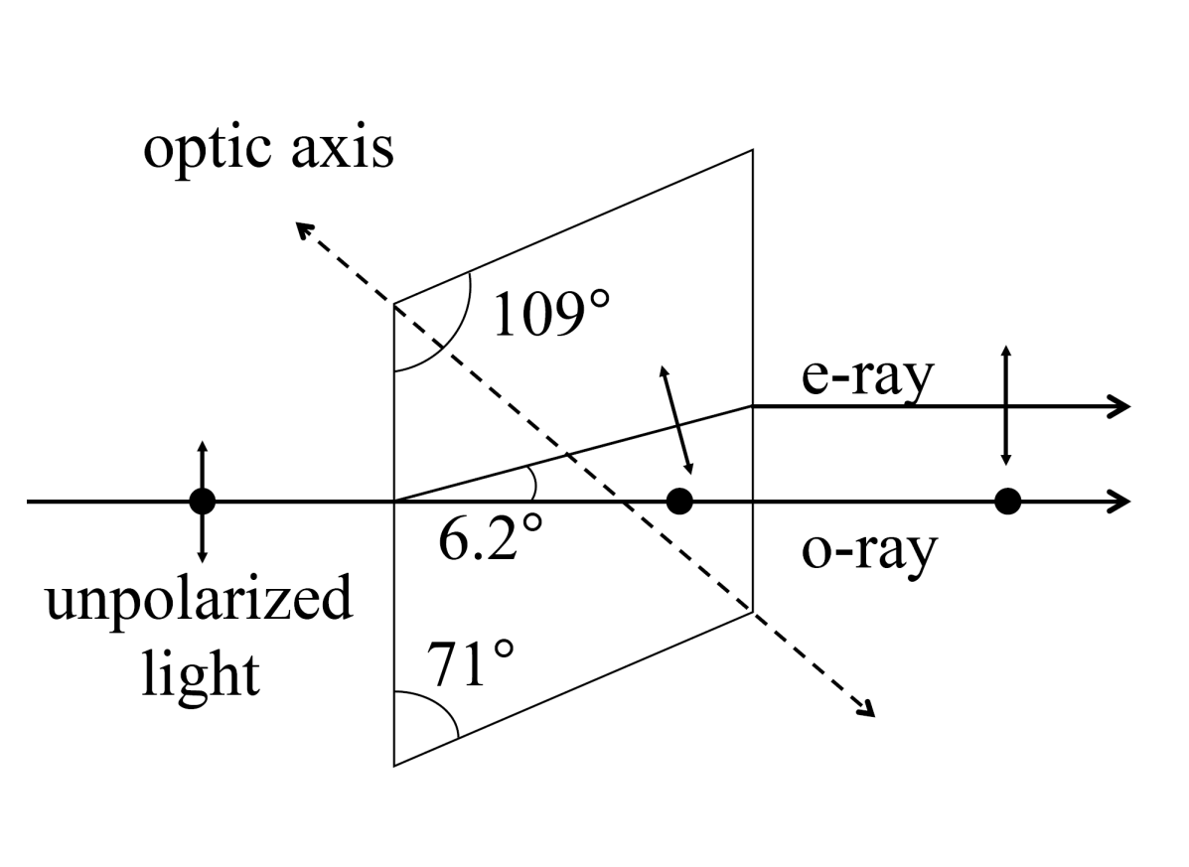
Double refraction in calcite
入射面，主截面，负折射
Birefringent crystals
such as calcite
(Iceland Spar)
separate orthogonal
light polarizations
into the
o(rdinary) and
e(xtraordinary) rays
Birefringence (optical anisotropy) : refractive index depends on the direction of the polarization vector relative to the crystal axes

Slide 26
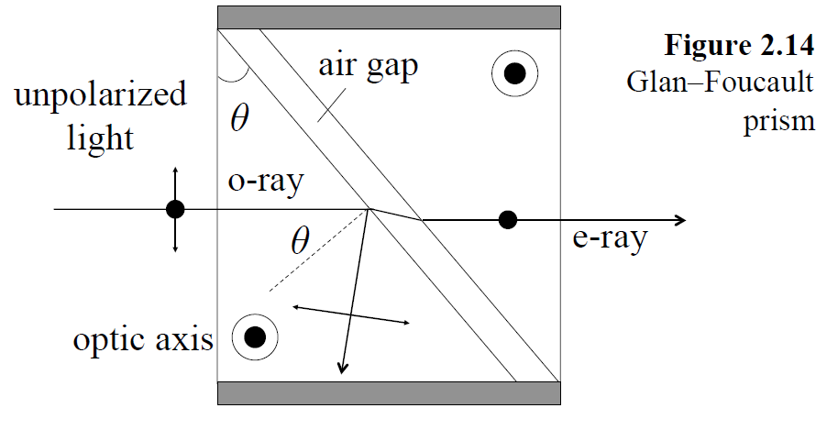
Polarizing beams splitters
Critical angle: sinθ_{c} = 1/n
Calcite: n_{o} = 1.658, θ_{c} = 37.1°; n_{e} = 1.486, θ_{c} = 42.3°
Hence choose 37.1 ≤ θ ≤ 42.3°

Slide 27
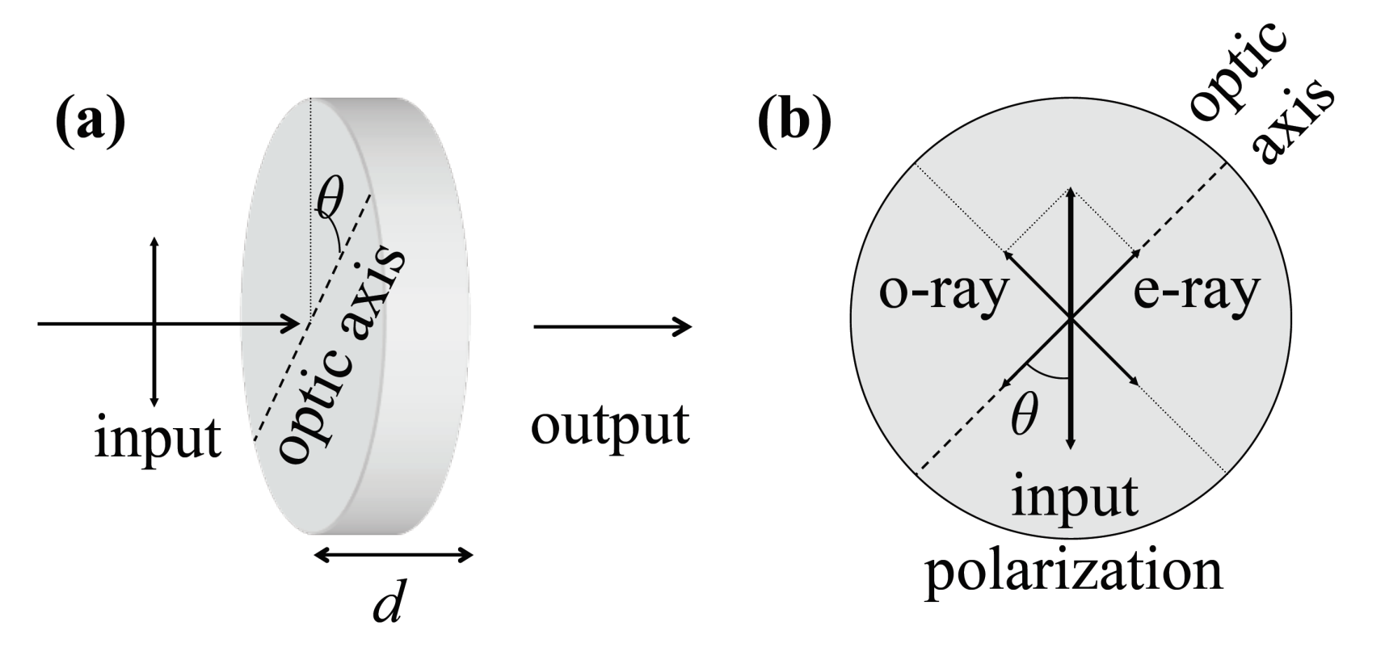
Wave plates
Half wave plate: Δφ=π
Quarter wave plate: Δφ=π/2

Slide 28
Induced birefringence
• Isotropic materials are non-birefringent
• Induce birefringence Δn with strain or electric field
• Hence photo-elastic and electro-optic effects
• Kerr effect (quadratic electro-optic effect) observed in
all materials, including liquids and glass:
Δn = λKE²; K = Kerr constant
• Hence Kerr cells (see Fig. 11.8)
• Contrast with linear electro-optic effect (Pockels effect)
observed only in anisotropic crystals

Slide 29
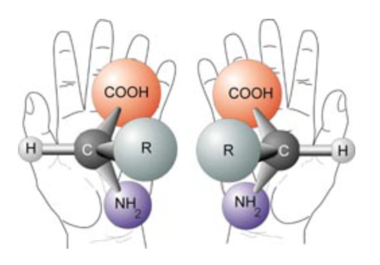
Chirality
• Optical properties different for left or right circularly polarized
light due to chirality (helicity) of molecules or crystal
structure
• Circular dichroism: different absorption for left or right
circular light
• Optical activity: different refractive index for left or right
circular light.
• Optical activity causes rotation of linear light: Examples:
dextrose, laevulose (fructose) [latin dexter, laevus]
amino acid

Slide 30
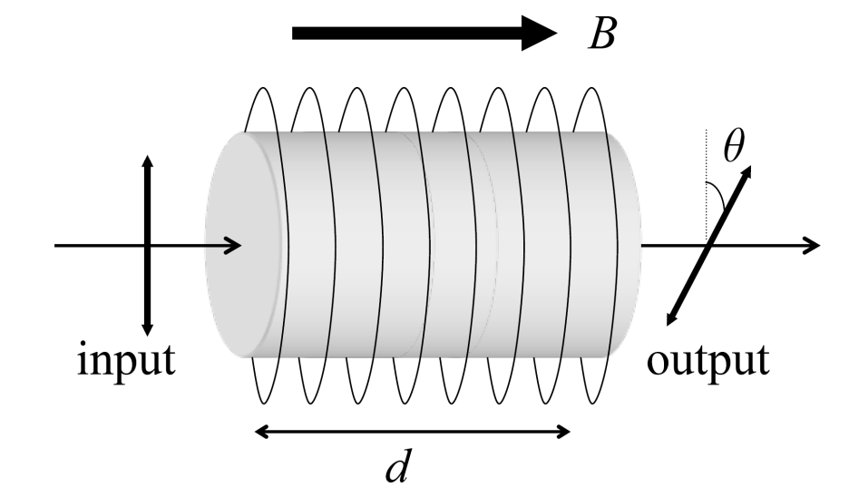
Magneto-optics: The Faraday effect
• Induce chirality in non-chiral materials with a magnetic
field
• magnetic circular dichrosim in absorbing materials
• Faraday effect in transparent materials: rotation of linear
polarization by magnetic field
θ = V B d ;
V = Verdet coefficient

Slide 31
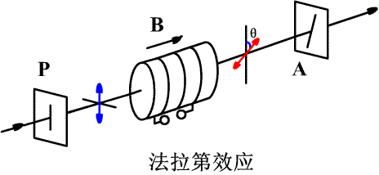
n,κ 调控
Kerr effect 1875,
Pockels effect 1893
3. Si 中等离子体色散效应,
4. 折射率的热光效应（Si）
5.手征与圆偏振调控
Modulator
Notes:
Kerr effect 1875, Scottish physicist
Pockels effect 1893 German physicist

Slide 32
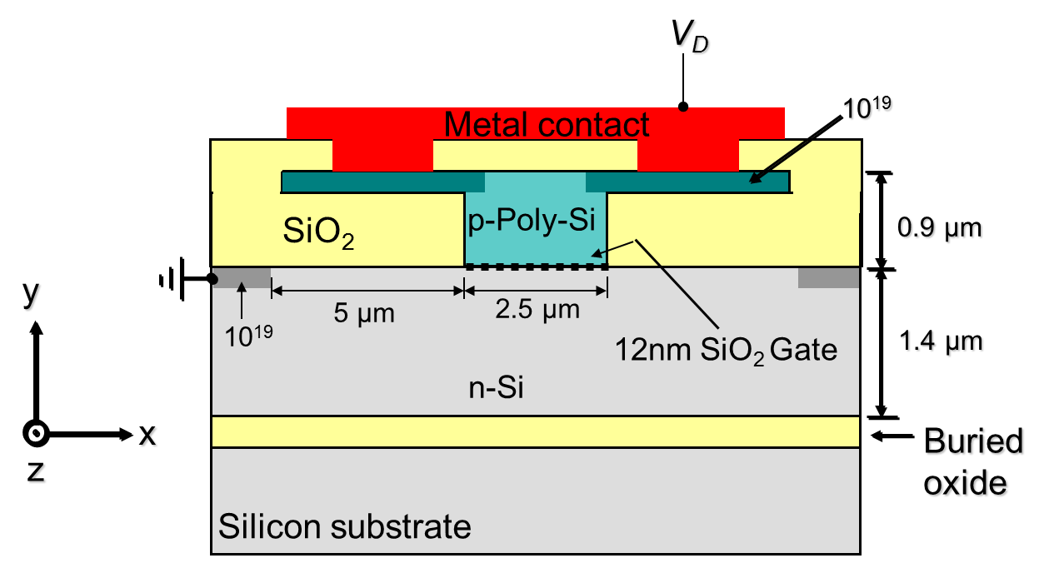
MOS optical waveguide/Modulator
Carrier injection p-i-n diode in forward bias
Strong effect (many carriers)
Slow effect (~1GHz)
Carrier depletion
p-n diode in reverse bias Weaker effect → hence device length large
Fast effect (>40GHz)
Intel 04 Nature
Change of free carrier density alters Si refractive index & absorption
Notes:
余金中 半导体光子学 P261 有推导。其中用到1）对自由载流子，ω0->0; 2）透明区 γ->0

Slide 33
课堂总结
Notes:
经典传播模型
K－K关系
n, κ 调控

Slide 34
作业
A certain material has a single absorption band which runs from photon energy E₁ to E₂. On the assumption that the absorption coefficient has a constant value α₀ within the band, and is zero elsewhere, use the K-K relationship to show that the refractive index for a photon energy E below E₁ is given by
Note：
also by use of the relationship of ω and E and that of α and κ
Exercise 2.12 M. Fox 2nd, P59

Slide 35
作业（选作）
A damped oscillator with mass, natural frequency ω₀, and damping constant γ is being driven by a force of amplitude F₀ and frequency ω. The equation of motion for the displacement x of the oscillator is as show in the following equation. Now,
What is the phase of x relative to the phase of the driving force?
M.Fox, 1st , Ex 2.2, 可观看视频后直接写出答案。

Slide 36
附：K-K关系之证明
P56, Electrodynamics of Solids
Dressel and Grűner, Cambridge

Slide 37
Kramers－Kronig relations
Linear response：
response function
External perturbation
Local approximation:
Non local effect
P. C. Martin,
Phys Rev 161,143(1967)
The law of causality and effect:

Slide 38
Kramers－Kronig relations
In Fourier space:
凑

Slide 39
Kramers－Kronig dispersion relationships
色散：实部与虚部之间的内在关系，即K-K变换关系。
In complex frequency plane for mathematical reason
For
when ω₂→∞
(The law of causality and effect)

Slide 40
响应函数性质：Lorentz模型
在 ω 的复平面
i. Analytic ：在上半复平面包括实轴解析
ii. Convergent ：when ⎢ω ⎢→∞ 时, G (ω ) →0，
G (ω )/ω在上半复平面内的无限半圆周上积分为0；
iii. Parity: G*(-ω) = G(ω)
对实的ω，复G(ω)的实部为偶函数，虚部为奇函数，如极化：
f_{i}---振子强度

Slide 41
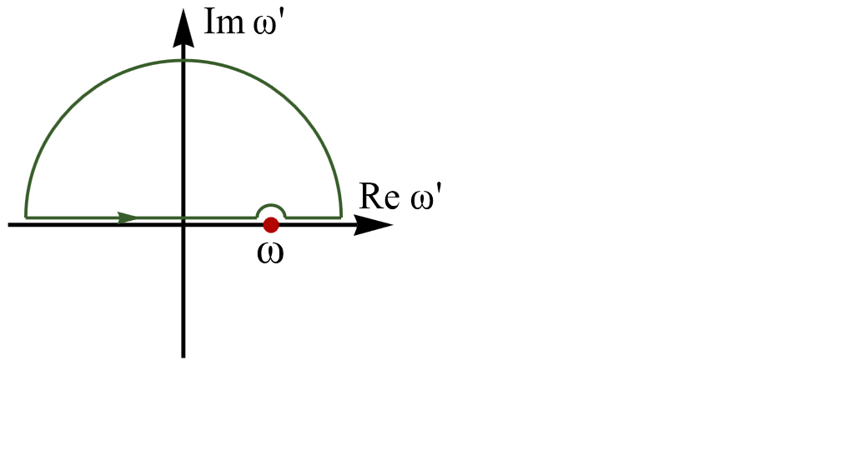
响应函数实部和虚部的关系
（Cauchy’s theorem）
在ω 的复平面内，采用的积分回路C
①
C
②
③
①
②
③
note
留数定理

Slide 42
响应函数K-K变换

Slide 43
交流电导中的K-K关系
是响应函数

Slide 44
介电函数中的KK关系
极化率：
是响应函数
Notes:
接下来通过积分域的数学变换 和 低频直流电导的直接引入，把上式修正以适合半导体的情况。Go on

Slide 45
积分域变换（数学）
若奇函, 此项留；
若偶函, 此项留
σ ₂(ω)是奇函;
σ ₁(ω)是偶函;

Slide 46
积分域变换（数学）
ε₂(ω)是奇函；ε₁(ω)是偶函
note
传导电导
原式仅适用于绝缘体
ω→0, ε₂ →0
对金属和半导体:
Notes:
待证 ？？？

Slide 47
ε∼σ关系 （备用）
n, κ
ε₁, ε₂
σ₁, σ₂
Note
Local Approximation
The relationship
附录
比对下划线： ；
再由 Eqn 7.15知
Notes:
Note:
σ1 in phase term, 同步，对电场的响应
σ2 out of phase, 感生项， 对电场响应

Slide 48
ε∼σ关系(备用)
P 23 半导体光学 2nd 沈学础

Slide 49
ε₂的修正
原仅适用于绝缘体
半导体光学
2nd 沈学础
2
适用至半导体

Slide 50
介电常数中的KK关系

Slide 51
折射率中的KK变换
已知
当⏐ω⏐→ ∞ 时,
收敛；解析性和奇偶性同χ
故 （n-1）+iκ的实虚部满足KK关系

Slide 52
折射率中的KK关系
×
（证毕）

Slide 53
SiO₂ optical fiber
80%
95%
衰减
http://nobelprize.org/nobel_prizes/physics/laureates/2009/phyadv09.pdf

Slide 54
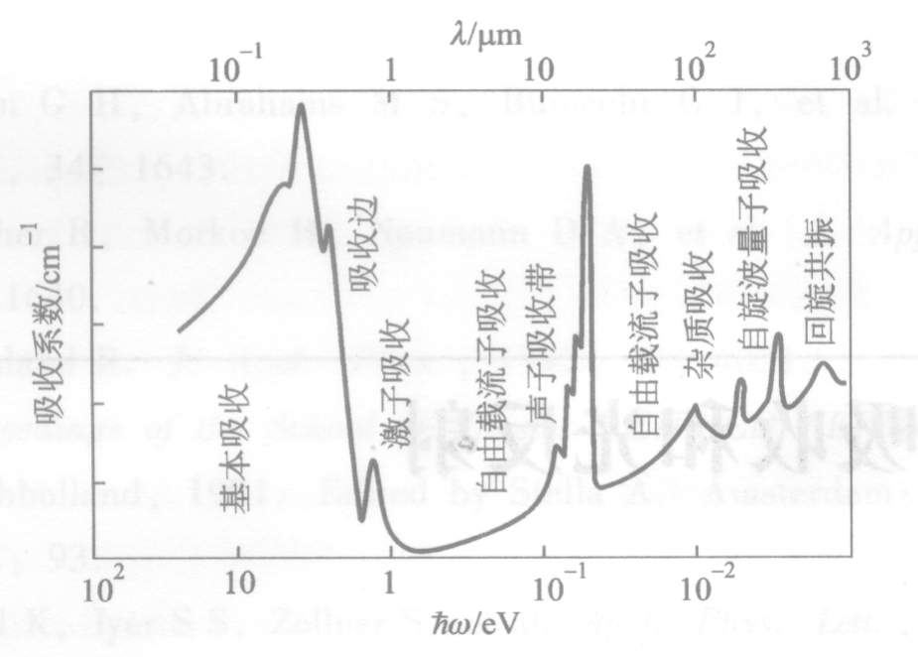
附
半导体中光的吸收谱 (概念)
自由载流子吸收
自由载流子吸收
光吸收系数:

